Slide 1


Non-invasive Blood Glucose Monitoring System
Presented by
Rupayan Saha
Abir Lal Manna
Sarthak Chakraborty
Debasmita Das
University of Engineering & Management, Kolkata

Slide 2

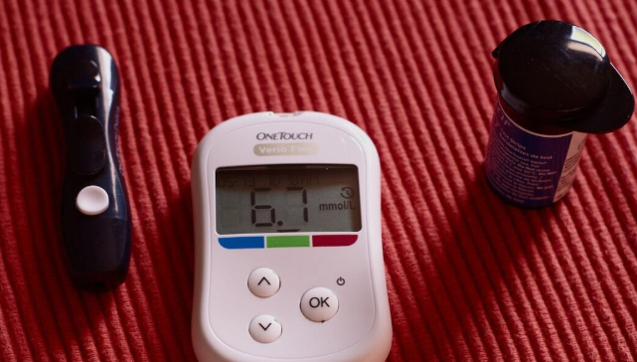
Why
Non-Invasive Glucometer ?
•Painless monitoring
•Portable and compact
•Environmentally friendly
•Customizable and open-source,
•Real-time readings
•Low cost maintenance
•User-friendly interface

Slide 3
Problem Statement
Painful Finger Pricking
Infection Risk Increases
High Ongoing Cost
Inconvenient Frequent Monitoring
Low User Compliance

Slide 4


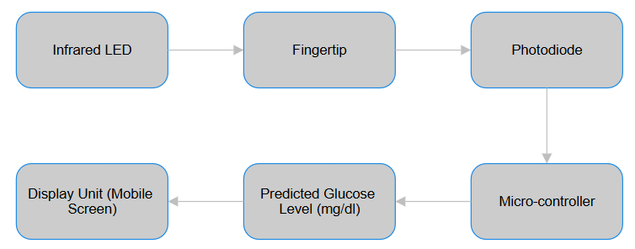
Block Diagram

Slide 5

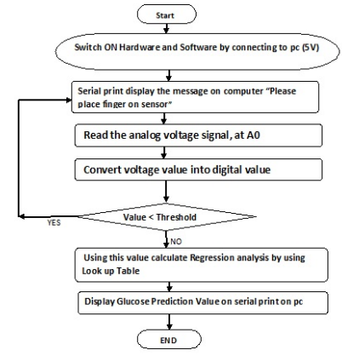
Flow Diagram

Slide 6
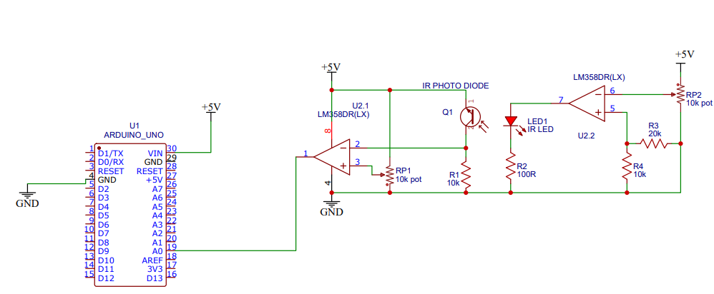
Experimental
Model
CIRCUIT DIAGRAM

Slide 7
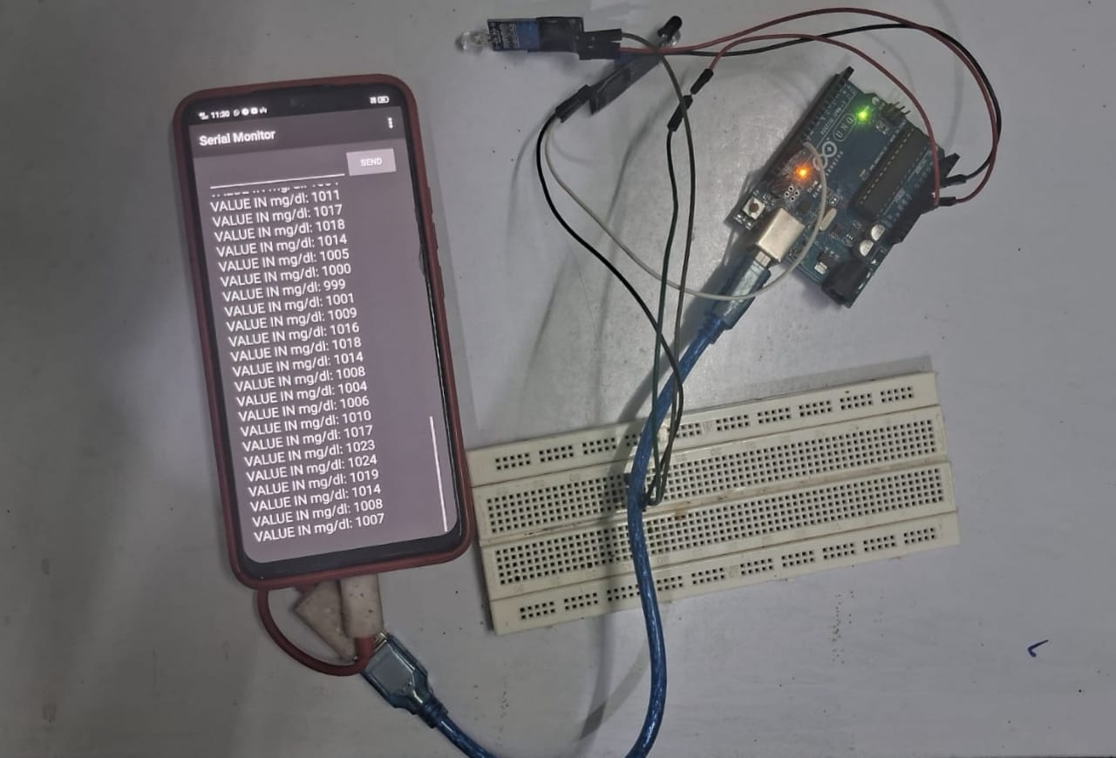
Experiental MODEL
FULL SETUP

Slide 8

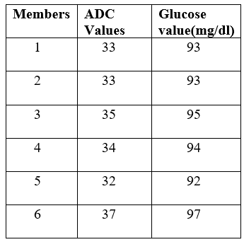
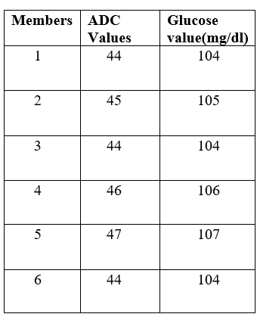
Result & Analysis
TABLE 1: PRE MEAL GLUCOSE LEVEL
TABLE 2:POST MEAL GLUCOSE LEVEL
Glucose=1*ADC Value + 60

Slide 9
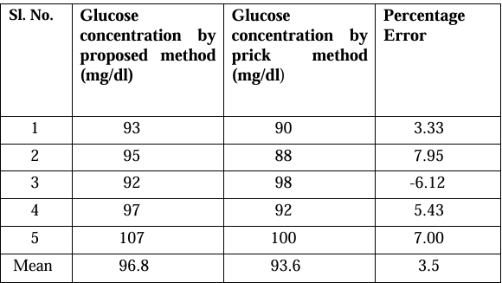
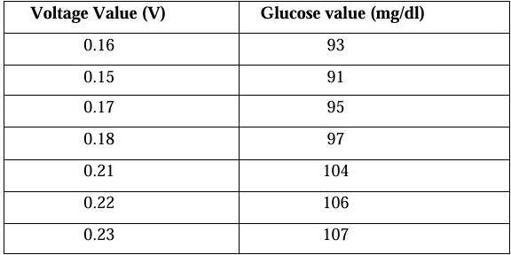
Result & Analysis
TABLE 3:
CALCULATION OF PERCENTAGE ERROR
TABLE 4: APPROXIMATE VOLTAGE AND PREDICTED GLUCOSE VALUE

Slide 10
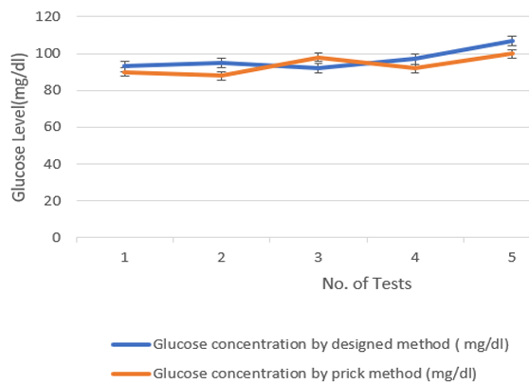
Result & Analysis
Close Agreement: The designed method closely follows the trend of the prick method across all 5 tests.
Slight Variations: Minor fluctuations exist, but both methods show glucose levels within a similar range (around 90–105 mg/dl).
Improved Consistency: The designed method exhibits slightly more consistent readings with narrower error bars.
Positive Correlation: Overall, both methods demonstrate a strong correlation, supporting the accuracy of the non-invasive technique.
GRAPH 1: PRICK METHOD VS. DESIGNED METHOD

Slide 11
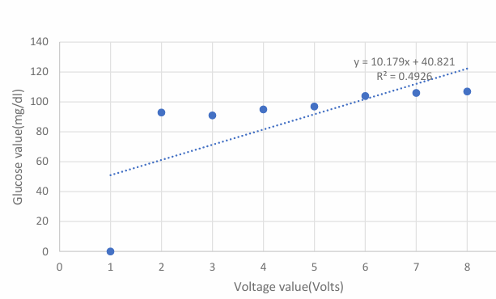
Result & Analysis
Positive Correlation: Glucose value increases with voltage, indicating a direct relationship between sensor output and glucose concentration.
Linear Trendline: The equation y=10.179x+40.821y = 10.179x + 40.821y=10.179x+40.821 models the data, helping convert voltage to glucose (mg/dL).
Moderate Fit (R² = 0.4926): The R² value suggests a moderate correlation, implying some variance .
GRAPH 2: REGRESSION ANALYSIS OF GLUCOSE DATA WITH VOLTAGE

Slide 12
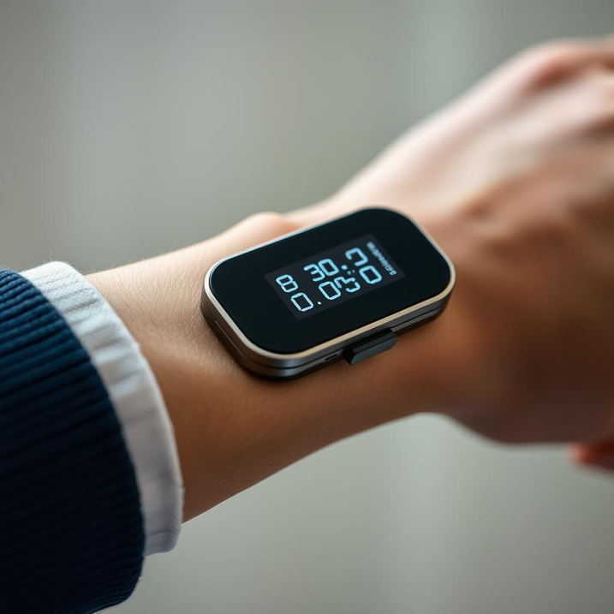
Applications
Daily glucose tracking for diabetic patients without discomfort.
Real-time monitoring in wearable health devices.
Remote health assessment for telemedicine and home care.
Preventive screening tool in clinics and health camps.

Slide 13

Future Scope
Real-time Monitoring & AI
Smart Integration & Connectivity
Wearable Design & Accessibility

Slide 14
BIBLIOGRAPHY
[1] S Coster, MC Gulliford, PT Seed, JK Powrie, R Swaminathan,”Monitoring blood glucose control in diabetes mellitus”, a systematic review, Health Technology Assessment, vol. 4, no.12, 2000.
[2] B. Paul, M.P. Manuel, Z.C. Alex, ”Design and development of non invasive blood glucose measurement system”, Physics and Technology of Sensors (ISPTS), 2012 1st International Symposium,Pune, India,7-10 March 2012, pp.43 46.
[3] Komal lawand, Shital Patil ,Mahesh Parihar, “ Non Invasive blood glucometer”, Journal of International Advance Research In Science And Engineering( IJARSE), Vol. No.3, Issue No.12, December 2014.
[4] O. Abdallah, A. Bolz, J. Hansmann, H. Walles, and T. Hirth, ” Design of a Compact Multi-Sensor System for Non-Invasive Glucose Monitoring Using Optical Spectroscopy” , IEEE Conference on Electronics, Biomedical Engineering and its Applications (ICEBEA’2012), Jan. 7-8, 2012 Dubai.
[5] S. F.Malin, T. L. Ruchiti, T. B. Blank, S. U. Thennadil, and S. L. Monfre,” Noninvasive prediction of glucose by near-infrared diffuse reflectance spectroscopy,” Journal of Clinical Chemistry, vol. 45, pp. 16511658, 1999.
[6] Jason J Burmeister, Mark A Arnold and Gary W Small,” Noninvasive Blood Glucose Measurements by Near-Infrared Transmission Spectroscopy across Human Tongues”, Journal on Diabetes Technology July 5, 2004.

Slide 15
Thank You!

